Slide 1
Secure Image Processing using Paillier Homomorphic Encryption
By
M.Sukresh
A.Chandu
T.Charan Kumar Reddy

Slide 2
Abstract
As per the information reported to and tracked by the Indian Computer Emergency Response Team (CERT-In), 3,94,499 and 11,58,208 cyber security incidents have been observed during 2019 and 2020. So the demand for privacy is more important consideration for digital data maintenance and handling in the systems.
Securing data online against attackers is a big challenge to achieve. We can achieve this with cryptographic algorithms. Cryptographic algorithms like RSA,AES,DES etc provide best data protection. These are very easier to compute and difficult to crack. But there are a some drawbacks in these encryption algorithms like Quantum Computing etc.
This Project uses the Paillier Homomorphic(partial) System to encrypt the image data and perform image processing techniques on it.

Slide 3
Objective
Paillier cryptosystem is a probabilistic asymmetric algorithm for public key cryptography. The problem of computing n-th residue classes is believed to be computationally difficult. It can perform some image processing operations on encrypted data(Both RGB and Gray Scale). The project is made to achieve this operations :
Encrypt/Decrypt Image
Brightness Increase
Increase Color
Multiply By Constant
Swap Colors
Flip Image
Mirror Image

Slide 4
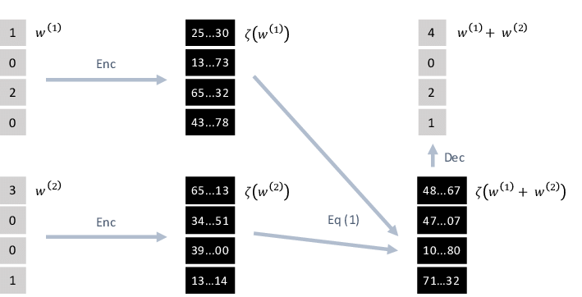
Homomorphic Encryption
Homomorphic Encryption is a form of encryption that permits users to perform computations on its encrypted data without first decrypting it.

Slide 5
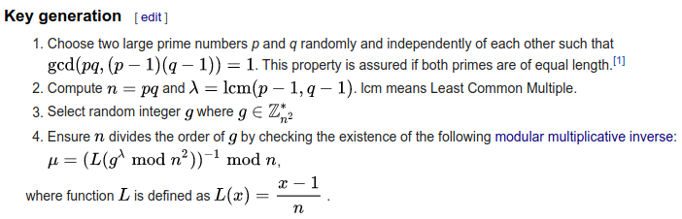
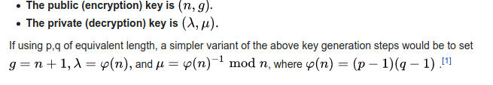
Algorithm

Slide 6

Key Generation Example

Slide 7

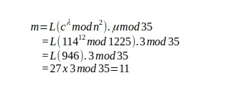
Encryption
Decryption

Slide 8
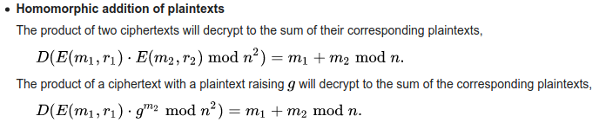
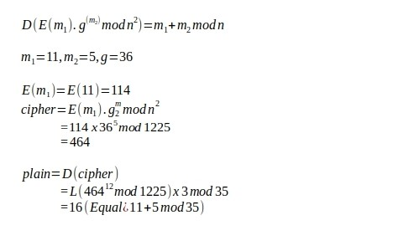
Homomorphic Addition

Slide 9
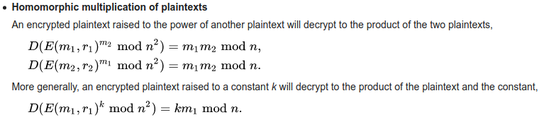
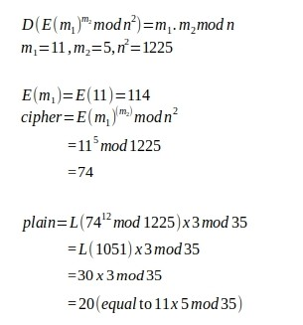
Homomorphic Multiplication:

Slide 10

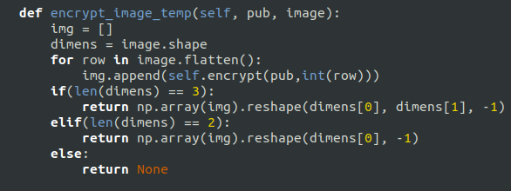
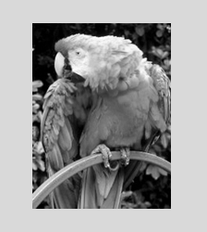
Image Encryption
Encrypted Image
Original Image

Slide 11
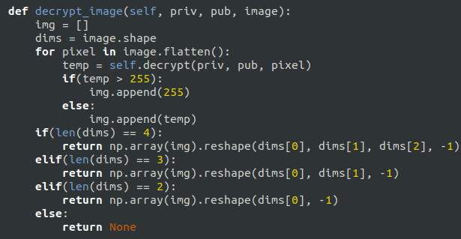
Image Decryption
Encrypted Image
Decrypted Image

Slide 12
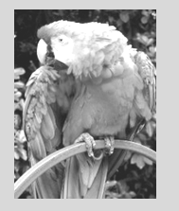
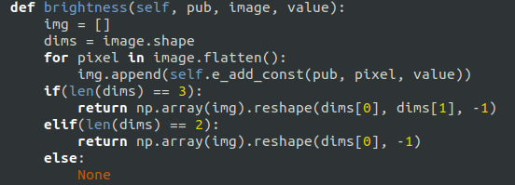
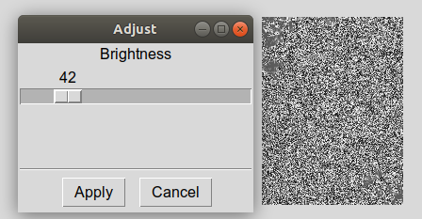
Brightness Increase
Before
After
Brightness value increasing on encrypted Image(value=42)

Slide 13
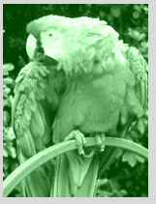
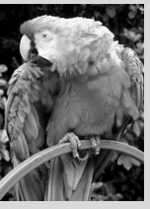
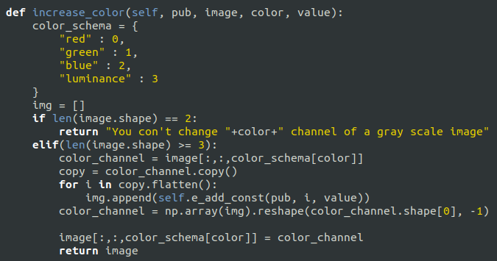
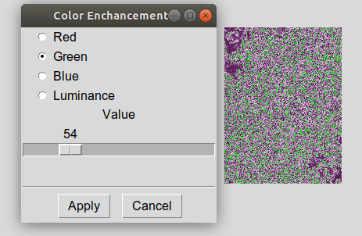
Color Enhancement
After
Before
Green color enhancing with value 54 on encrypted image

Slide 14
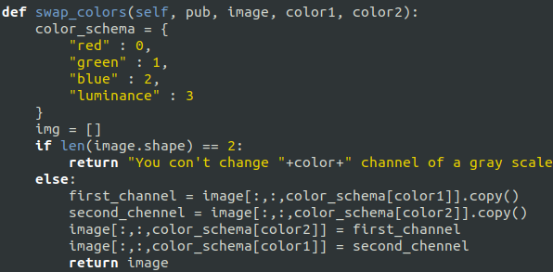
Swap Colors

Slide 15
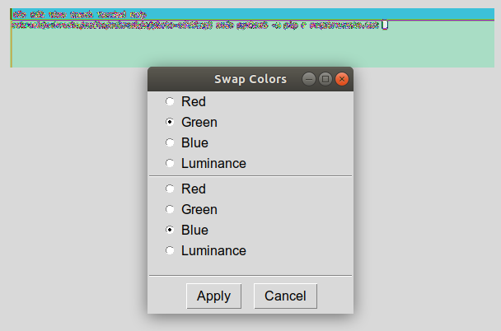


Swapping green with blue on encrypted Image
After
Before

Slide 16

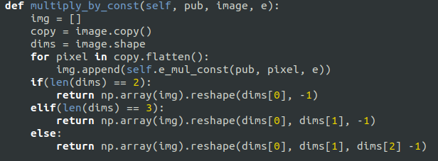
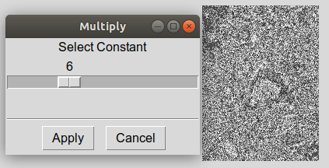
Multiply by constant
After
Before
Multiply by every pixel by value 6

Slide 17
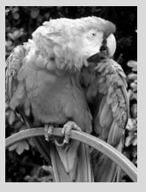
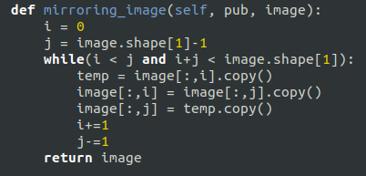
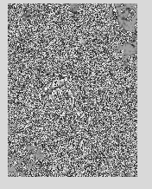
Mirror Image
After
Before
Mirroring image operation performed on encrypted image

Slide 18
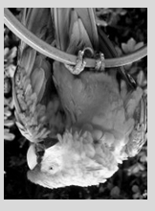
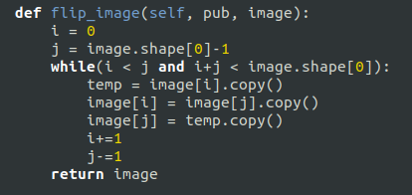
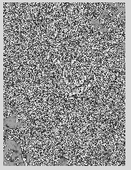
Image Flipping
After
Before
Flip operation performed on encrypted image

Slide 19
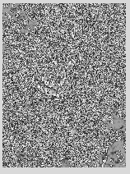
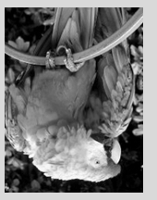
Performing any Two Operations at a time
Performed both Mirror and Flip Operations
After
Before

Slide 20
Conclusion
In this project, we proposed a model for exploring Image processing operations on the encrypted images by adapting Paillier Homomorphic cryptosystem.
As the practical implementation is successfully done for the proposed model,Experimental results are proven that the image processing operations are possible on the encrypted images so as to preserve the privacy and confidentiality with a complete control of user.
The Paillier cryptosystem is deterministic as per the nature but in our practical implementation capacity limits are very small to achieve it. So we only implemented indeterministic Paillier cryptosystem practically.

Slide 21
Thank You Madam for your support

